Slide 1
Lead Scoring Assignment
Marcus Ng

Slide 2
Contents
Problem statement
General Approach
Data Cleaning
Visualising Data
Building Model
Evaluation
Summary

Slide 3
Problem Statement
X Education, an online education provider for professionals, attracts daily website visitors interested in its courses. These leads come from various marketing channels, including websites and search engines like Google. After engaging with the site, they may explore courses or submit contact information, becoming leads. The sales team then contacts them, aiming for a 30% conversion rate.
Despite many leads, X Education struggles to convert them efficiently. They want to identify 'Hot Leads' for better conversion, focusing on the most promising prospects. Nurturing leads through education and personalized communication is crucial.

Slide 4
Objectives
Build a model that gives leads a score of between 0 and 100.
Use Logistic Regression to help increase the conversion rate to 80%

Slide 5
General Approach
The general approach here is to first, inspect and clean the dataset before visualizing the remaining data. That way it will help provide insights that we can use for the building of the model.
After building the model, evaluate the results and use it on the test set.

Slide 6
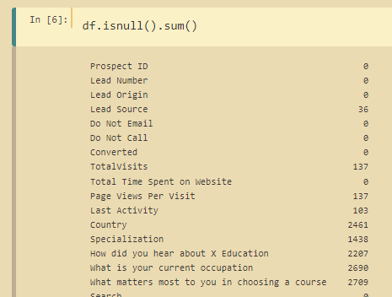
Data Cleaning
We start of by identifying how many null values there are in each column. This will help us determine if we should drop them.
We can see from the results that there are quite a number of columns with plenty of missing values.

Slide 7
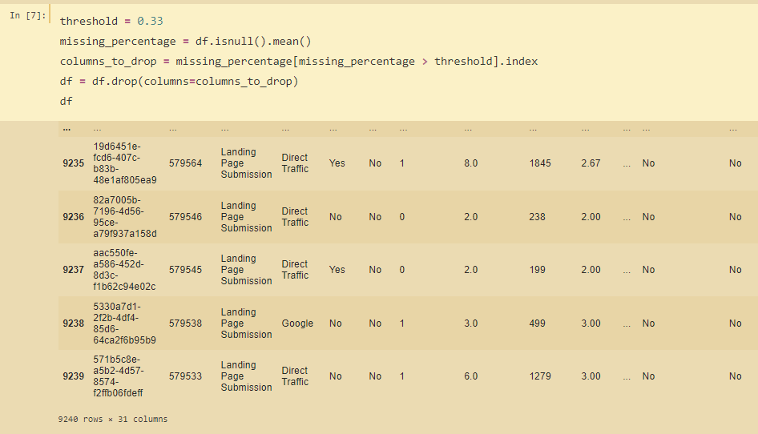
Data Cleaning
I then proceeded to remove a column on condition that at least 33% of the columns have missing values. Why 33% because this ensures that we have 2/3 of data remaining for us to run the algo.
If the dataset is too small, we may not yield useful results from our model.

Slide 8

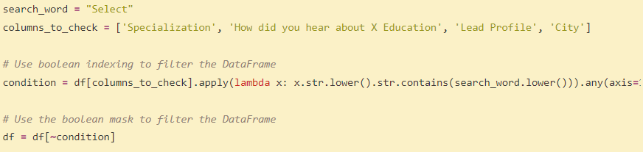
Data Cleaning
I also noticed that a number of columns have “select” as a value. I am quite certain this is wrong as it could perhaps be a user interface issue.
Instead of dropping the columns, I noticed that some of them still have plenty of values that can provide info. Hence I drop those rows instead

Slide 9
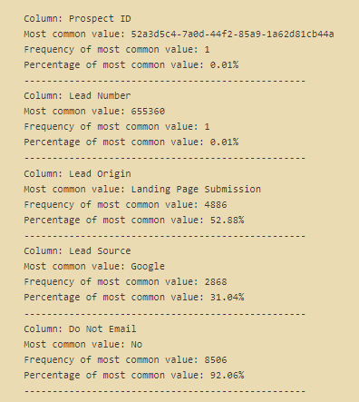
Data Cleaning
I also checked if there are cases where a column have too many of the same values. This will provide more insight for later

Slide 10
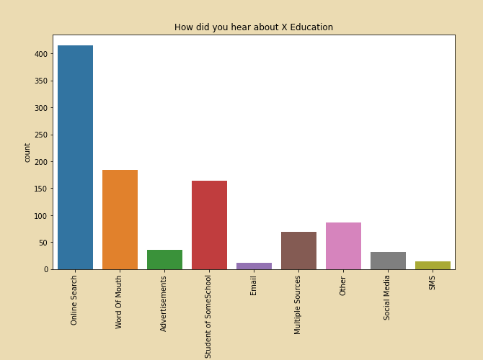
Visualizing Data
Most people have heard about X Education from Online Searches. This means that the SEO techniques used by the company is working well.

Slide 11
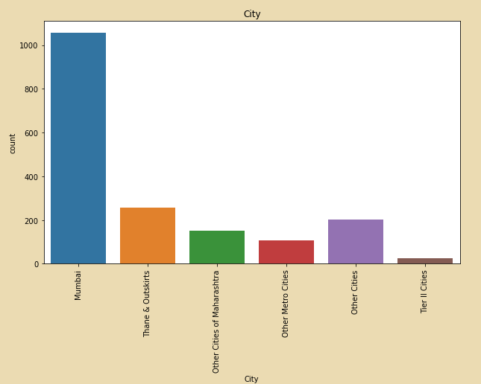
Visualizing Data
Most people come from Mumbai instead of other cities.

Slide 12
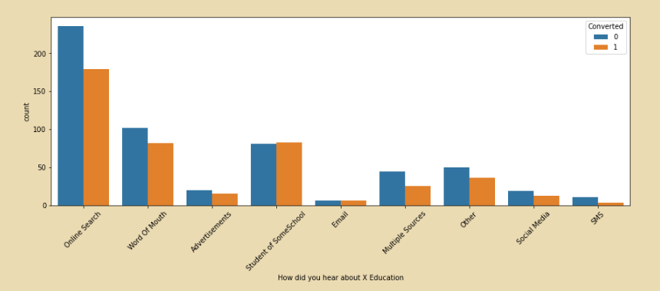
Visualizing Data
The image on the left shows a few things:
Online searches have very high conversions but the rate at which customers are converted is lower than the rest.
Others such as word of mouth and Advertisements fair much better but have lower absolute number of conversions

Slide 13
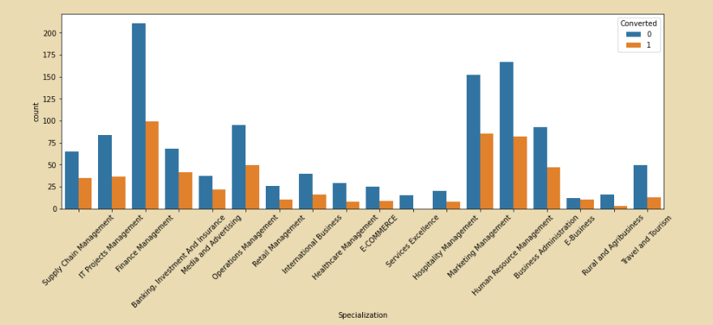
Visualizing Data
The conversion rate between the different specializations are also very different.
Some such as IT Project Managers have lower conversion rate. This is useful as the company can train its callers to be better prepared in targeting these customers

Slide 14
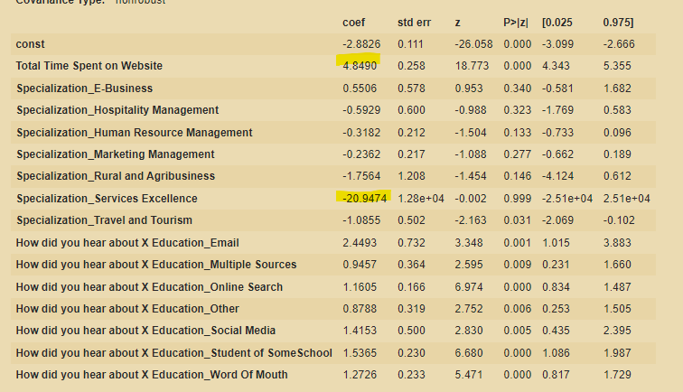
Building Model
Building a model requires a few tries. In my first few tries, I drop columns with high coef such as the ones below. Doing so will help improve my result.

Slide 15
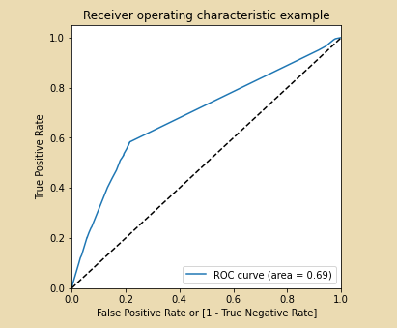
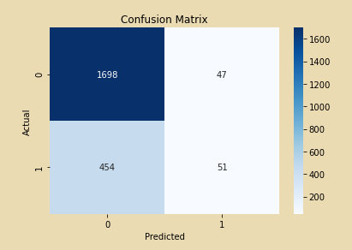
Model Eval
The confusion matrix from my result shows that the model did fairly well. However, I can further improve this by plotting the ROC curve.

Slide 16
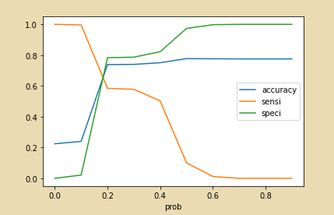
ROC Curve
The tradeoff value here is 0.2. This means that we can consider Prospect lead with conversion probability higher than 20% to be a hot lead.

Slide 17
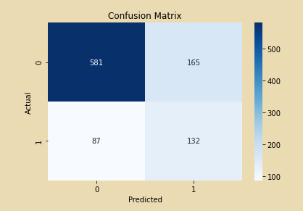
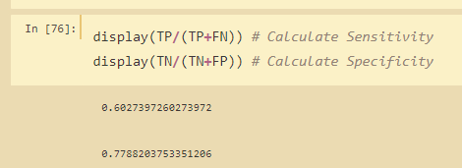
Model Eval
The model did fairly well with a much better sensitivity and specificity that before plotting the ROC Curve

Slide 18
Summary
We see that there are some sources such as online searches doing very well in attracting initial customers. However, they have lower conversion rate than others.
We also see very low conversion rate for some specializations. Apart from the model, the company callers should be trained in handling these customers to better clarify any queries they have to increase conversion rates.
Leads who spend lot of time on the websites are also more likely to convert to customers
We also see most customers from Mumbai.

